Slide 1
AI PROJECT Dino Game Playing Using Reinforcement Learning
Presented by:-
Arzoo Jangra - 6
Dhirender Kumar - 10
Vidhi Khare - 54
Submitted to:- ​
Dr. Punam Bedi

Slide 2
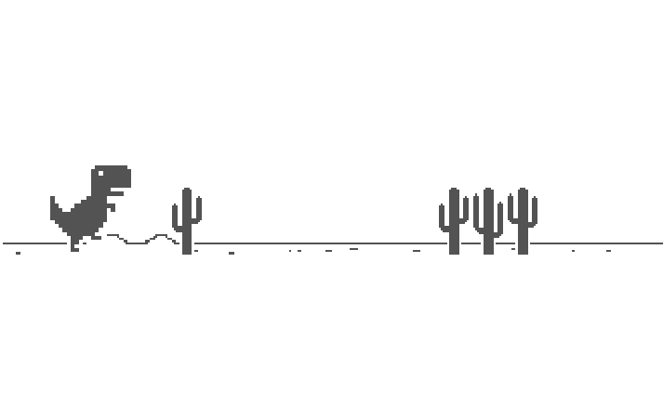
Dino Run or T-Rex run is an endless runner game in Chrome browser which is available to play when you’re offline aka ‘the game you don’t usually like to see’.

Slide 3
Technologies Used
Python Selenium Package
Reinforcement learning
Git/Github
Python
Numpy, Matplotlib, Pandas, Seaborn
Q-Learning

Slide 4
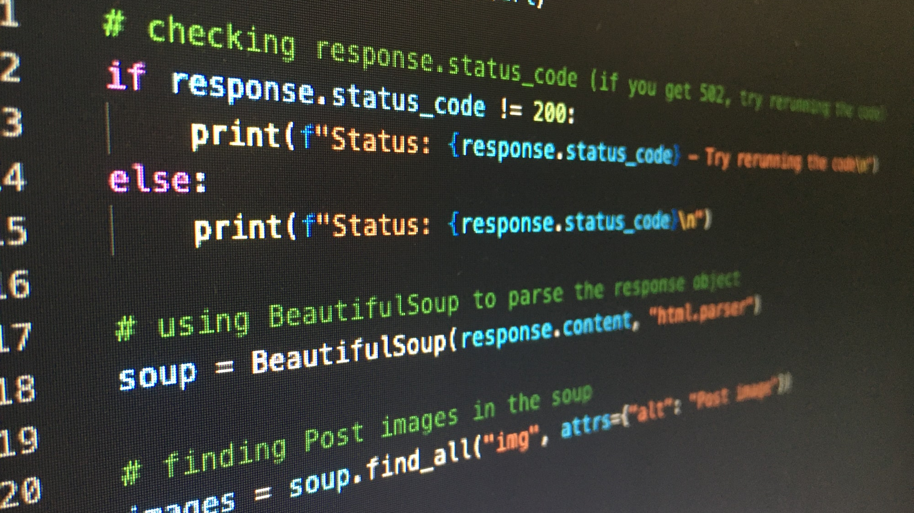
NumPy can be used to perform a wide variety of mathematical operations on arrays.
Matplotlib is a cross-platform, data visualization and graphical plotting library for Python.
Pandas is a Python library for data analysis.
Seaborn is a library in Python predominantly used for making statistical graphics.
Selenium, a popular browser automation tool, was used to send actions to the browser and get different game parameters like current score.

Slide 5
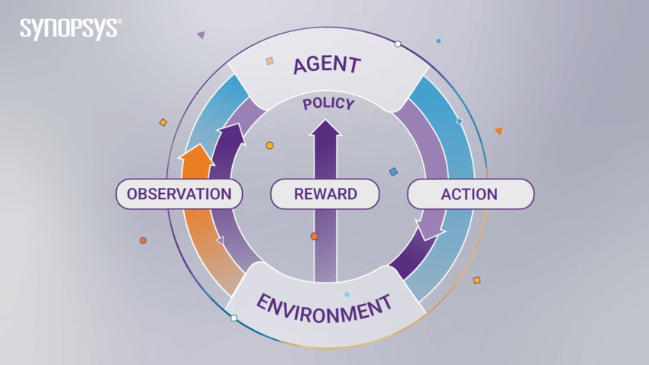
Supervised, Unsupervised, and Reinforcement Learning: What are the Differences?

Slide 6

Difference #1: Static Vs. Dynamic
The goal of supervised and unsupervised learning is to search for and learn about patterns in training data, which is quite static. RL, on the other hand, is about developing a policy that tells an agent which action to choose at each step — making it more dynamic.

Slide 7
Difference #2: No Explicit Right Answer
In supervised learning, the right answer is given by the training data. In Reinforcement Learning, the right answer is not explicitly given: instead, the agent needs to learn by trial and error. The only reference is the reward it gets after taking an action, which tells the agent when it is making progress or when it has failed.

Slide 8
Difference #3: RL Requires Exploration
A Reinforcement Learning agent needs to find the right balance between exploring the environment, looking for new ways to get rewards, and exploiting the reward sources it has already discovered. In contrast, supervised and unsupervised learning systems take the answer directly from training data without having to explore other answers.

Slide 9
Difference #4: RL is a Multiple-Decision Process
Reinforcement Learning is a multiple-decision process: it forms a decision-making chain through the time required to finish a specific job. Conversely, supervised learning is a single-decision process: one instance, one prediction.

Slide 10
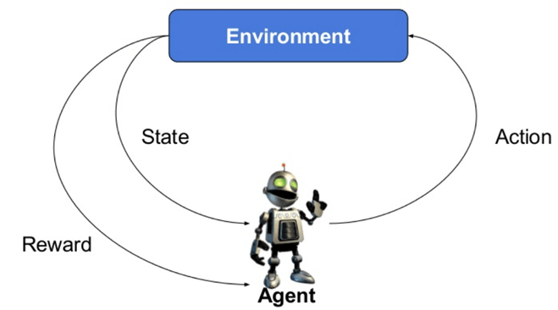
Reinforcement Learning
Reinforcement Learning is a feedback-based Machine learning technique in which an agent learns to behave in an environment by performing the actions and seeing the results of actions. For each good action, the agent gets positive feedback, and for each bad action, the agent gets negative feedback or penalty.

Slide 11
Elements of Reinforcement Learning
Reinforcement Learning has four essential elements:
Agent: The program you train, with the aim of doing a job you specify.
Environment: The world, real or virtual, in which the agent performs actions.
Action: A move made by the agent, which causes a status change in the environment.
Rewards: The evaluation of an action, which can be positive or negative.

Slide 12
Q-Learning
Q-learning is a popular values-based reinforcement learning algorithm based on the Bellman equation.
The main objective of Q-learning is to learn the policy which can inform the agent that what actions should be taken for maximizing the reward under what circumstances.
It is an off-policy RL that attempts to find the best action to take at a current state.
The ‘Q’ in Q-learning stands for quality. Quality here represents how useful a given action is in gaining some future reward.

Slide 13
Elements of Reinforcement Learning
According to our project
Agent: Dino
Environment: Web Browser
Action: Jump & Duck
Rewards: 15 for not getting out
Penalty: -1000 for getting out

Slide 14
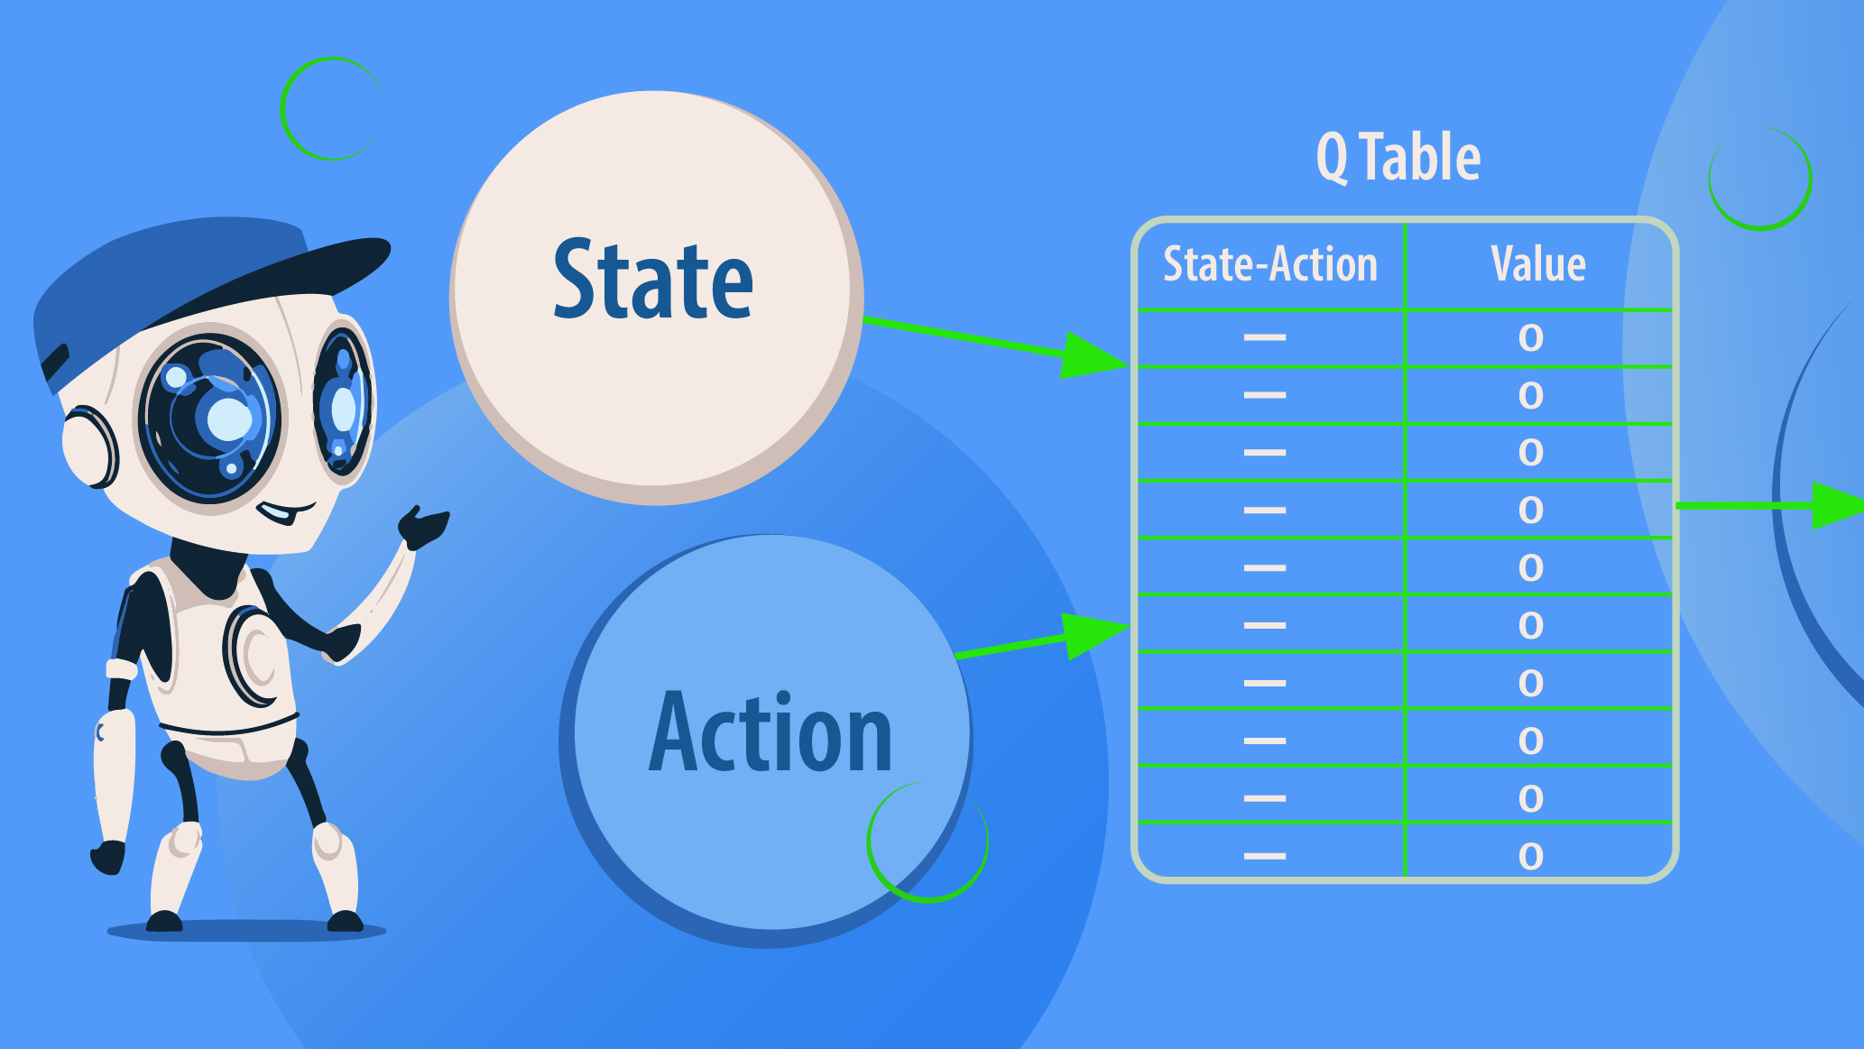
Q-Table
Q-Table is the data structure used to calculate the maximum expected future rewards for action at each state. Basically, this table will guide us to the best action at each state.

Slide 15
Q- Table According to our project
State |  |  |  |  |  | Action
Dino Information |  | Obstacle Information |  |  | Current speed of game | Do Nothing | Jump | Duck
X_Coordinate | Y_Coordinate | X_Coordinate | Y_Coordinate | Width
45 | 36 | 80 | 33 | 50 | 8 | 3 | 2.5 | -1
50 | 34 | 56 | 45 | 65 | 8 | 1 | 3 | -4
55 | 39 | 67 | 34 | 70 | 8 | 2 | 5.1 | -2
--- | --- | --- | --- | --- | --- | --- | --- | ---

Slide 16
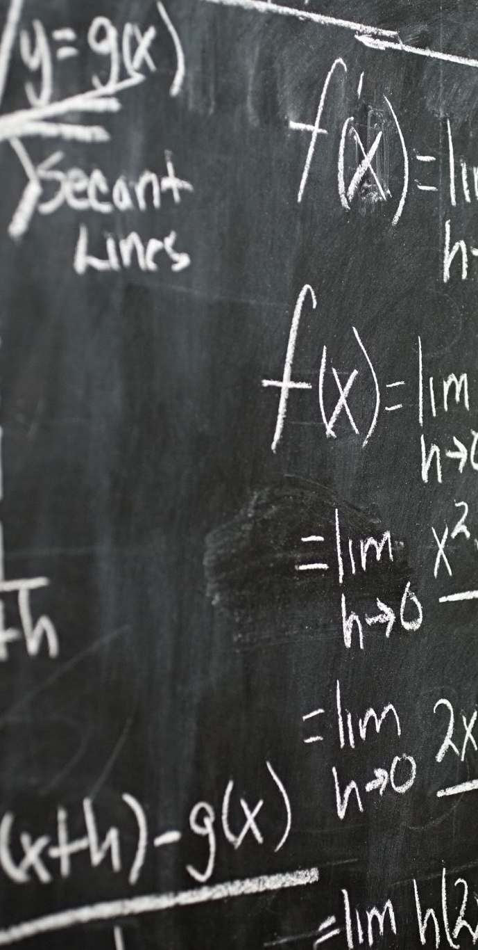
Maths behind Q-Learning
The goal of the agent in Q-learning is to maximize the value of Q-function [Q(s, a)], which uses the Bellman equation and takes two inputs state(s) and action(a).
Notations:
s = A particular state
a = Action
s' = State to which user goes from s
ϒ = Discount factor
α = Learning rate
R(s, a) = Reward function which takes a state s and action a and outputs a reward value.
Q'(s', a') = Expected future reward.

Slide 17
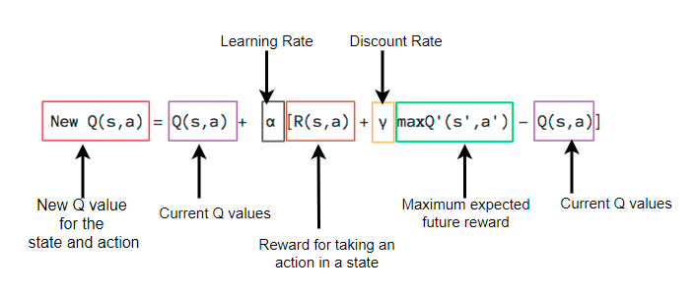
Q-function

Slide 18
Exploration vs Exploitation
Exploration vs Exploitation problem arises when our model tends to stick to same actions while learning, in our case the model might learn that jumping gives better reward rather than doing nothing and in turn apply an always jump policy. However, we would like our model to try out random actions while learning which can give better reward. We introduce ɛ, which decides the randomness of actions. We gradually decay its value to reduce the randomness as we progress and then exploit rewarding actions.

Slide 19
Credit Assignment Problem
Credit Assignment problem can confuse the model to judge which past action was responsible for current reward. Dino cannot jump again while mid-air and might crash into a cactus, however, our model might have predicted a jump. So the negative reward was in fact a result of previously taken wrong jump and not the current action. We introduce Discount Factor γ, which decides how far into the future our model looks while taking an action. Thus, γ solves the credit assignment problem indirectly. In our case the model learned that stray jumps will inhibit it’s ability to jump in the future when we set γ=0.99

Slide 20
Procedure
Game Initialization
Initialize the Variables and Q-Table
Start game playing
Get current state of dino
Check for the current state in the Q-Table
If current state is in Q-Table get the Q-Values for the given state
Else add this new state to the Q-Table and randomly generate its Q-Values
Based on the Q-Values take the action with highest Q-Value
Based on the result of the action update the Q-Values for the current (state, action).

Slide 21
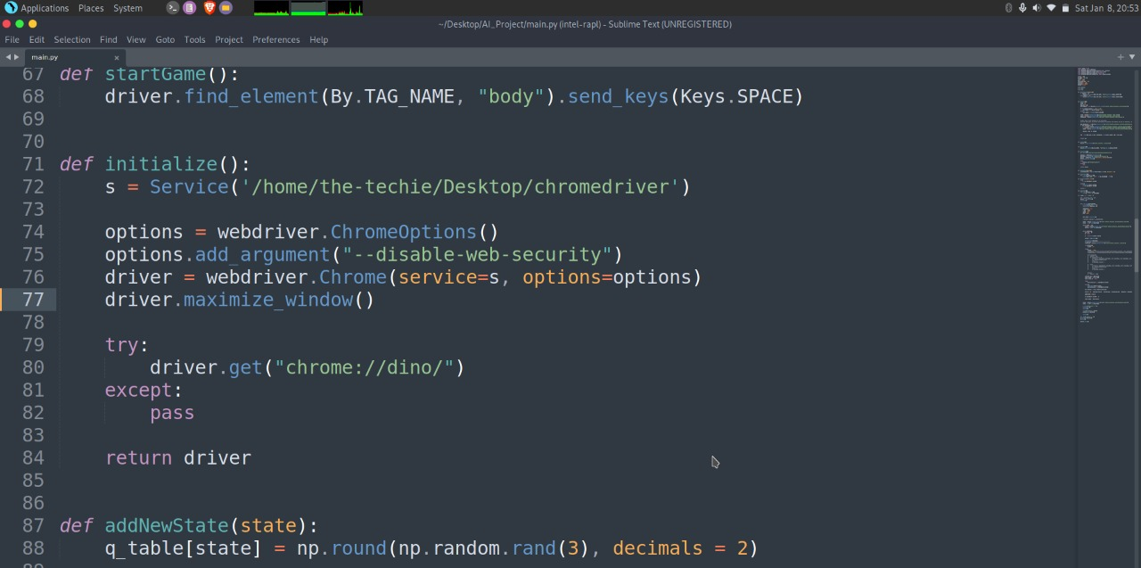
Game Initialization

Slide 22
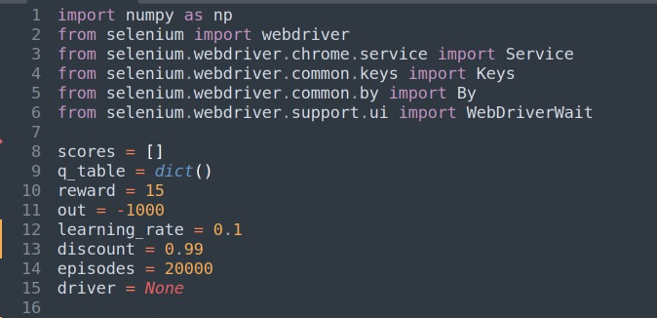
Initialize the Variables and Q-Table

Slide 23
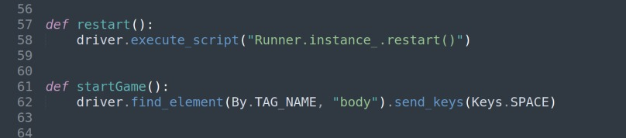
Start game playing

Slide 24
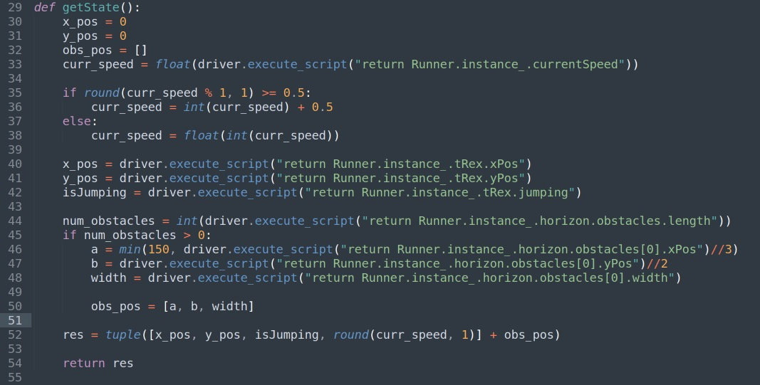
Get current state of Dino

Slide 25
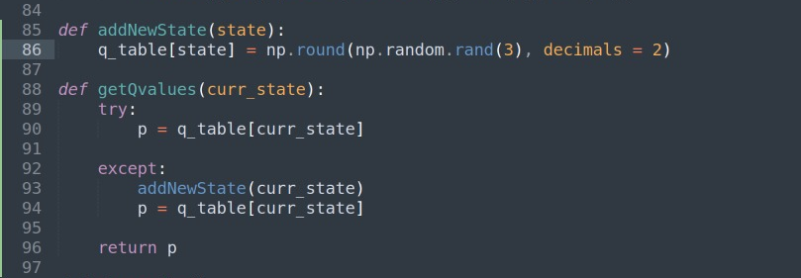
Get the Q-Value for the current state

Slide 26
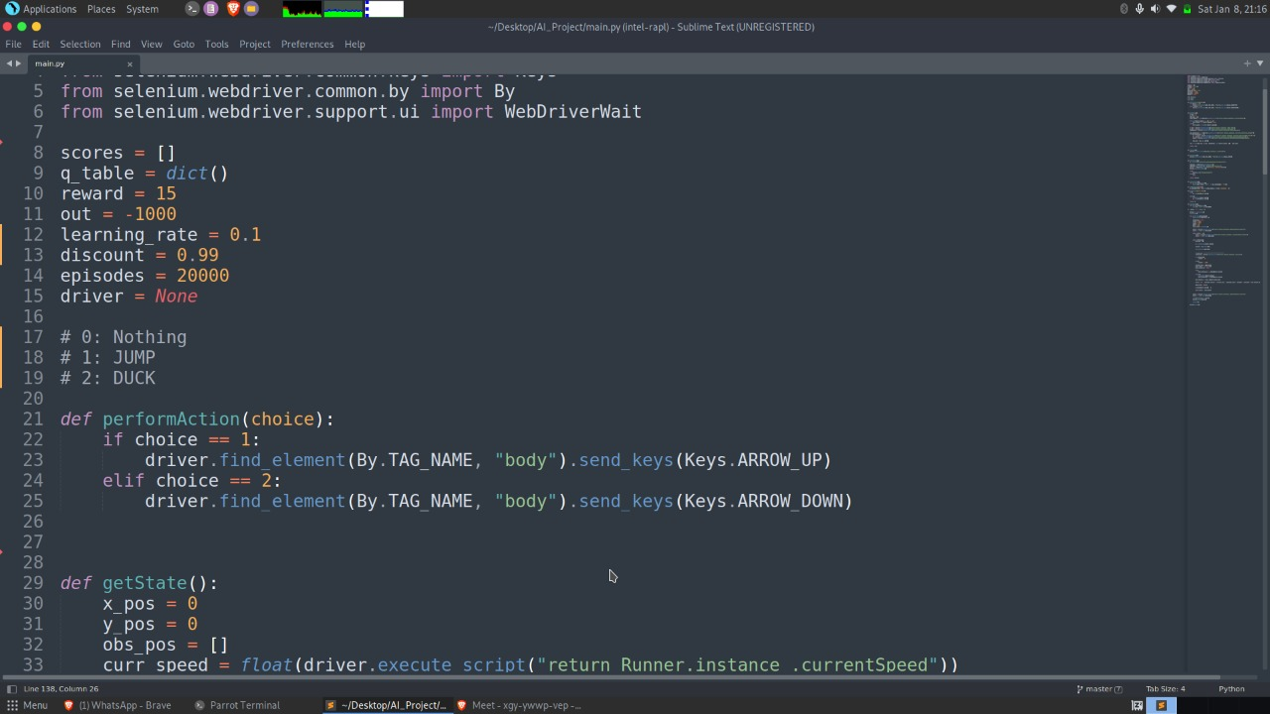
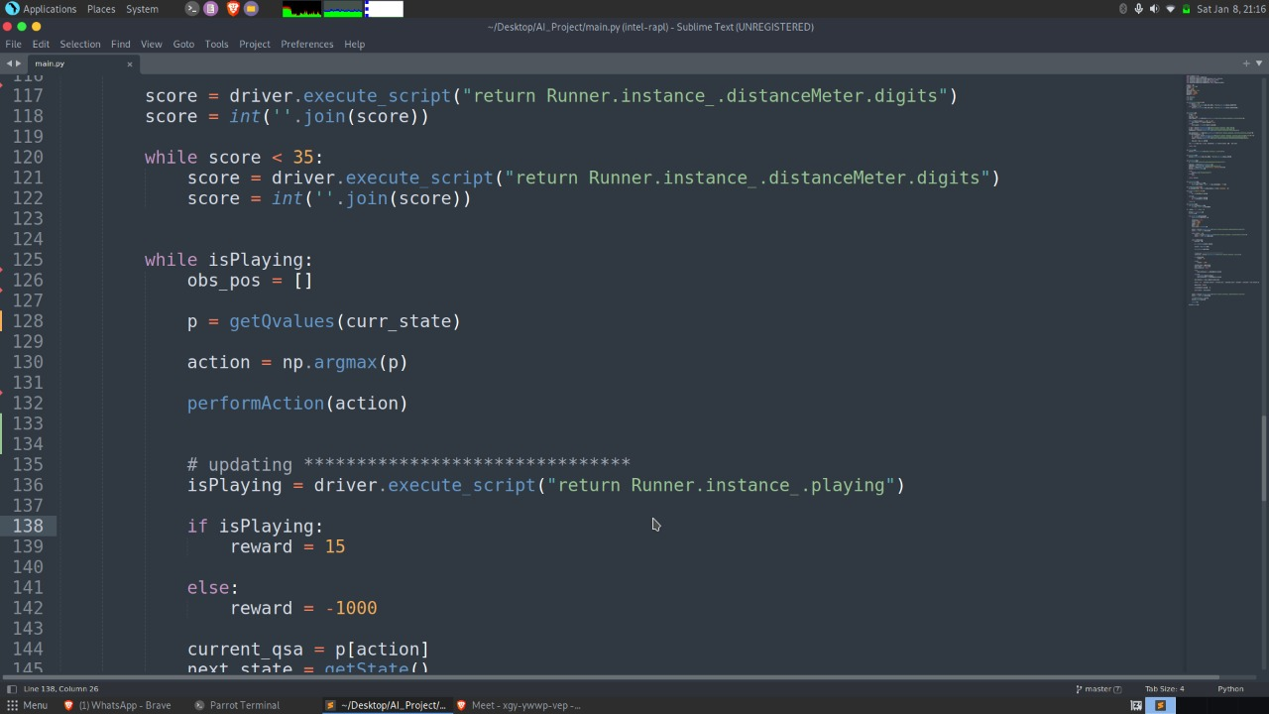
Based on the Q-Values take the action with highest Q-Value

Slide 27
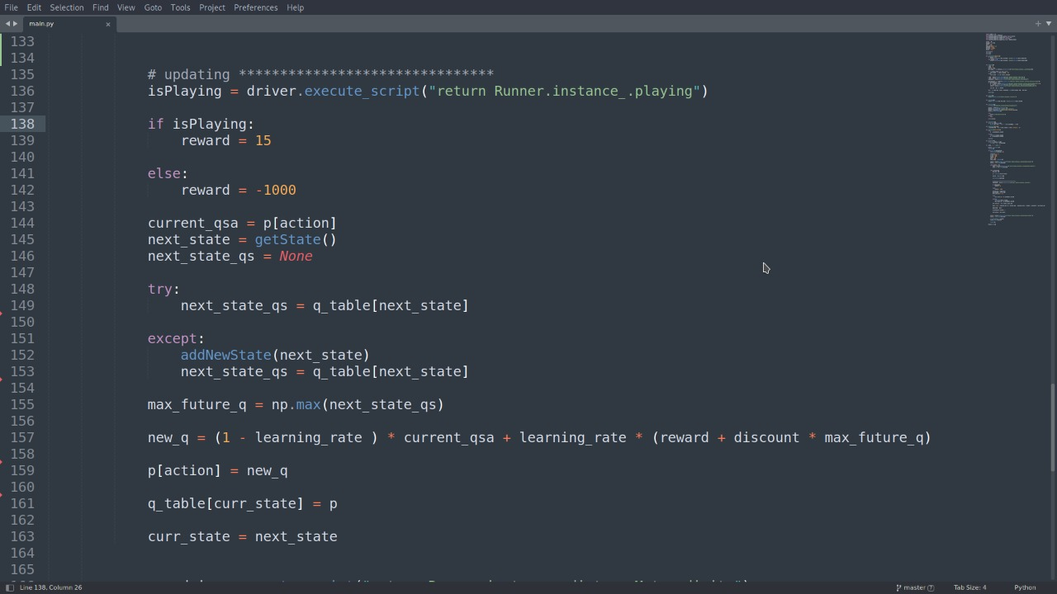
Based on the result of the action update the Q-Values for the current (state, action)

Slide 28
Week 2 updates (17-01-2022 to 23-01-2022)

Slide 29
Q- Table According to our project
State |  |  |  |  |  |  | Action
Dino Information |  |  | Current speed of game | Obstacle Information |  |  | Do Nothing | Jump | Duck
X-Coordinate | Y-Coordinate | Is Jumping (T/F) |  | X-Coordinate | Y-Coordinate | Width
0 | 82 | F | 6 |  |  |  | 1.96 | 0.36 | 0.39
23 | 93 | F | 6.5 | 150 | 52 | 51 | 0.62 | 2.36 | 0.87
23 | 93 | F | 8 | 78 | 52 | 51 | 2.19 | 0.21 | 0.27
23 | 70 | T | 6 | 14 | 52 | 51 | 0.51 | 0.1 | 0.2
---- | ---- | ---- | ---- | ---- | ---- | ---- | ---- | ---- | ----

Slide 30
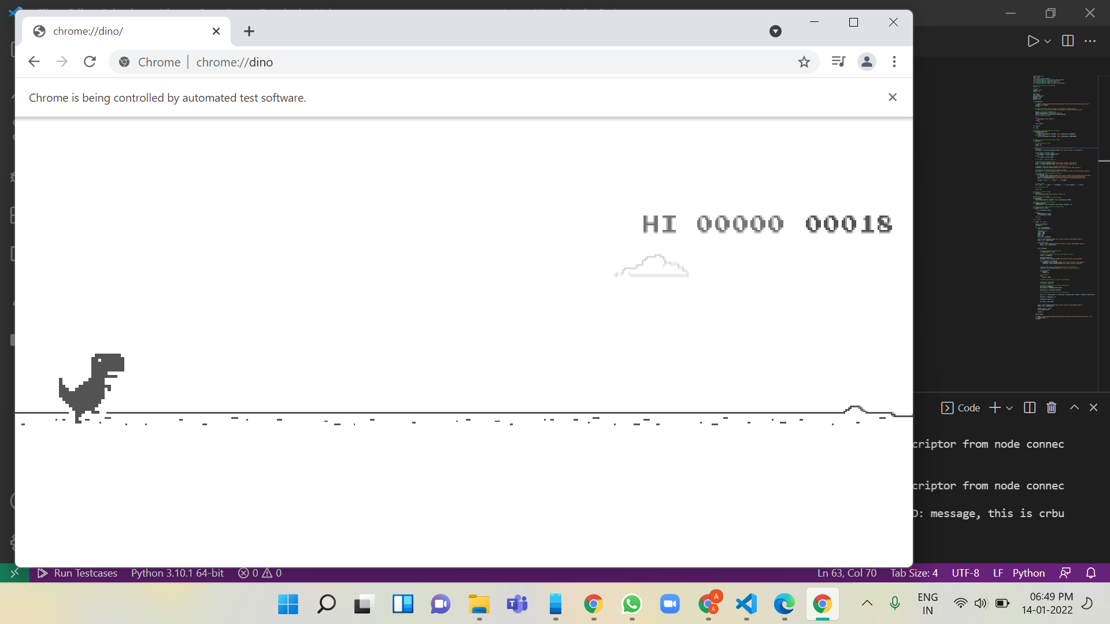
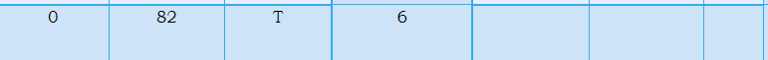
Explanation
We are performing a certain number of episodes in one run of the program.
At start of the game, we get the initial state of the Dino and the Obstacles(if present). Since in the image it can be seen that there is no obstacle present so our program only returns the state of the Dino (i.e. it's x-coordinate, y-coordinate, is it jumping or not, current speed of the game).
After getting the state, we retrieve the current score from the browser and while the score is less than 35, our Dino will do nothing.

Slide 31
If score>35 and our Dino is still playing then we try to get the Q-Value for the current state using getQvalues() method.
If current state of our Dino is not present in the Q-Table then we will add that state into the Q-Table by generating random Q-value for that state and generated Q-values would be returned by our method.
In our case it returns 0.45(for Nothing), 0.36(for Jump), 0.39(for Duck)
Current State ->
If the current state is already present in the Q-Table then the getQvalues() would simply retrieve the Q-values for the current state from the Q-Table and return it.
Further the Dino would perform action based on the action with highest Q-values.
In our case the max Q-value is 0.45 (Do Nothing - Index 0)
0 | 82 | T | 6 |  |  |  | 0.45 | 0.36 | 0.39

Slide 32
After taking the action we check if our Dino is still playing or not.
If alive we give Dino reward of 15
Else a penalty of –1000
If alive (Reward = 15)
We update the Q-value of the particular action taken for the current state to incur the effect of reward.
To calculate the updated Q-value we retrieve the state in which Dino is after performing the action.
We retrieve the next state, Q-values for the next state(next_state_qs) and also the maximum of the Q-values of this next state(max_future_q).
Next_state
Next_state_qs = [0.62, 0.95, 0.87]
Max_future_q = 0.95 for Jump
23 | 93 | F | 6 .5 | 150 | 52 | 51 | 0.62 | 0.95 | 0.87

Slide 33
Calculation to Update Q-Value, If Dino is Still playing
Now we calculate the updated Q-value using the Q-Function
new_q = [(1 - learning_rate ) * current_qsa] +
[learning_rate * (reward + discount * max_future_q)]
new_q = [(1 - 0.1) * 0.45] + [0.1 * (15 + 0.99* 0.95)]
new_q = [0.99*1.27] + [0.1*15.9405]
new_q = 0.4455 + 1.59405
new_q = 2.03
Now we update this calculated new_q in the q_table for the current state and for the action that was taken (I.e. Do Nothing)
Current State Initial
0 | 82 | T | 6 |  |  |  | 0.45 | 0.36 | 0.39
Current State Updated
0 | 82 | T | 6 |  |  |  | 2.03 | 0.36 | 0.39

Slide 34
Else (Reward = -1000)
Here the reward represents the penalty given to the Dino.
Penalty is given if the Dino gets out in the game.
We update the Q-value of the particular action taken for the current state to incur the effect of penalty.
To calculate the updated Q-value we retrieve the state in which Dino is after performing the action.
We retrieve the next state, Q-values for the next state(next_state_qs) and also the maximum of the Q-values of this next state(max_future_q).
Next_state
Next_state_qs = [0.62, 0.95, 0.87]
Max_future_q = 0.95 for Jump
23 | 93 | F | 6 .5 | 150 | 52 | 51 | 0.62 | 0.95 | 0.87

Slide 35
Calculation to Update Q-Value, If Dino is Still playing
Now we calculate the updated Q-value using the Q-Function
new_q = [(1 - learning_rate ) * current_qsa] +
[learning_rate * (reward + discount * max_future_q)]
new_q = [(1 - 0.1) * 0.45] + [0.1 * (-1000 + 0.99* 0.95)]
new_q = [0.99*1.27] + [0.1*(-940.5)]
new_q = 0.4455 - 94.05
new_q = -93.6045
Now we update this calculate new_q in the q_table for the current state and for the action that was taken (I.e. Do Nothing)
Current State Initial
0 | 82 | T | 6 |  |  |  | 0.45 | 0.36 | 0.39
Current State Updated
0 | 82 | T | 6 |  |  |  | -93.60 | 0.36 | 0.39

Slide 36
Further if Dino is alive we would make next state as our current state to work over the next state that we are in after taking the action.
We would go on performing the method listed in previous slides for all the upcoming states and fill up our Q-Table simultaneously to train our Dino.
If Dino gets out, a different episodes starts with the same process listed but with a filled Q-Table which it uses to train Dino.
After each episode we are storing the score that is generated and printing the same.

Slide 37
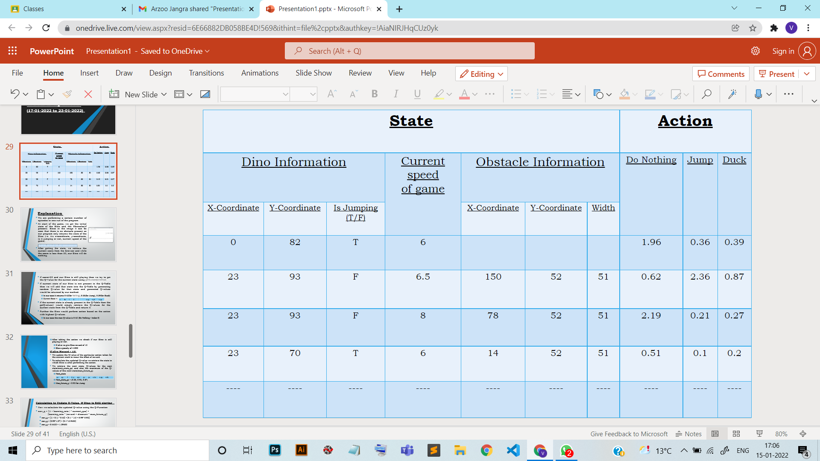
As we can see in the image that there is no obstacle on the screen in the very beginning of the game that's why the obstacle info part of the first row of our Q-table is empty.

Slide 38
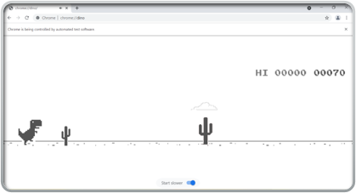
Now in the picture below we can see the obstacle arriving towards our Dino and hence the second row of our Q-table provides the information about the obstacle as well which helps it to perform action accordingly.

Slide 39
Training in batches
Previously, we had to train the model in one go.
Now, with the use of json file, we are able to train our model in batches and on multiple systems.

Slide 40
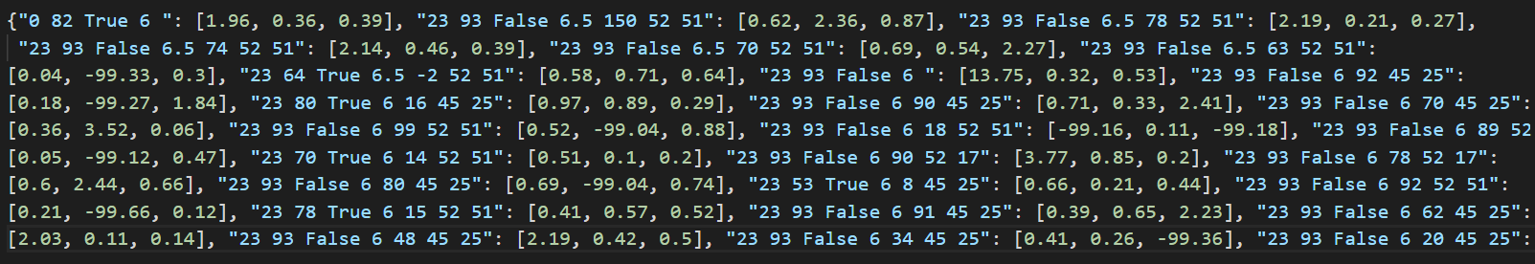
Json File
This file contains our Q-table for all the sessions which helps us to start a next session with this filled Q-table instead of starting with an empty Q-table which also helps us to train our model in different batches on different systems.
Json file snippet

Slide 41
Week 3 updates (14-02-2022 to 20-02-2022)

Slide 42
Training Phase
What are the parameter changes done for training to get the best results?
We are changing the learning rate in our program for training in different phases. (0.1 to 0.6)

Slide 43
Why we choose different values of learning rate for training ?
new_q = [(1 - learning_rate ) * current_qsa] +
[learning_rate * (reward + discount * max_future_q)]
Since it can be seen that learning rate is making a tradeoff between our current q-value and future q-value, thereby to get the effect of learning rate on both the values simultaneously, we chose learning rate to vary between 0.1 and 0.6 for our training.

Slide 44
Visualizations

Slide 45
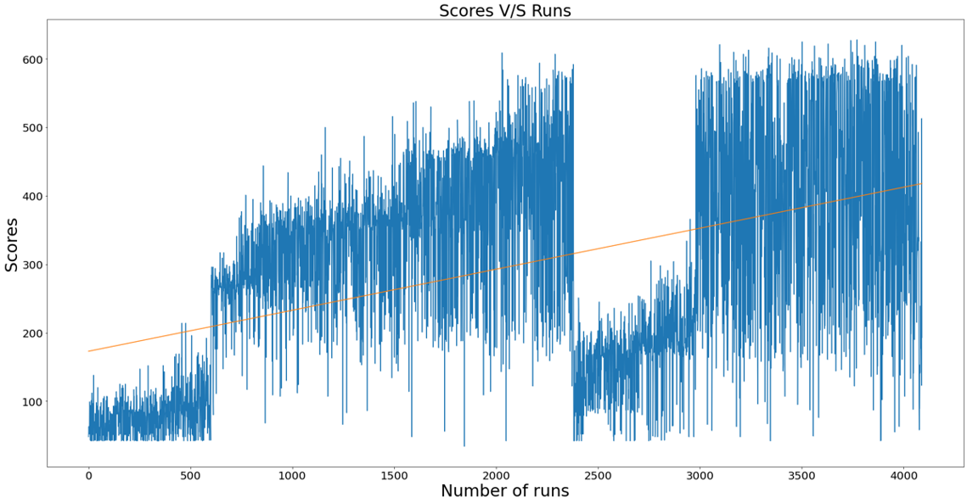
1st Parameter (Learning Rate - 0.1)

Slide 46
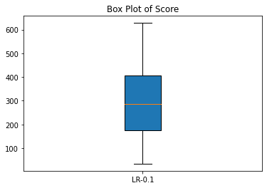
Five-number summary
First_quartile: 174.0
Max: 628
Median: 286.0
Min: 34
Third_quartile: 405.0

Slide 47
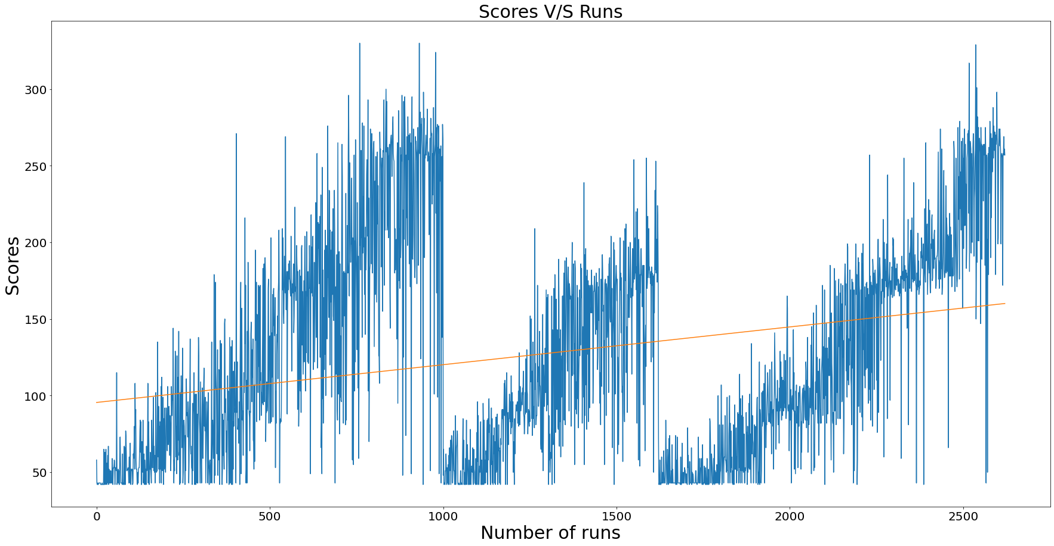
2nd Parameter (Learning Rate - 0.2)

Slide 48
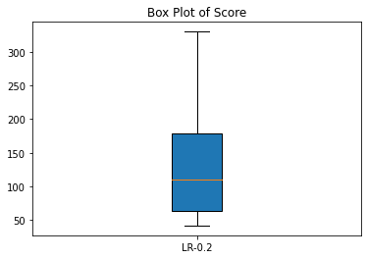
Five-number summary
First_quartile: 64.0
Max: 330
Median: 110.0
Min: 42
Third_quartile: 179.0

Slide 49
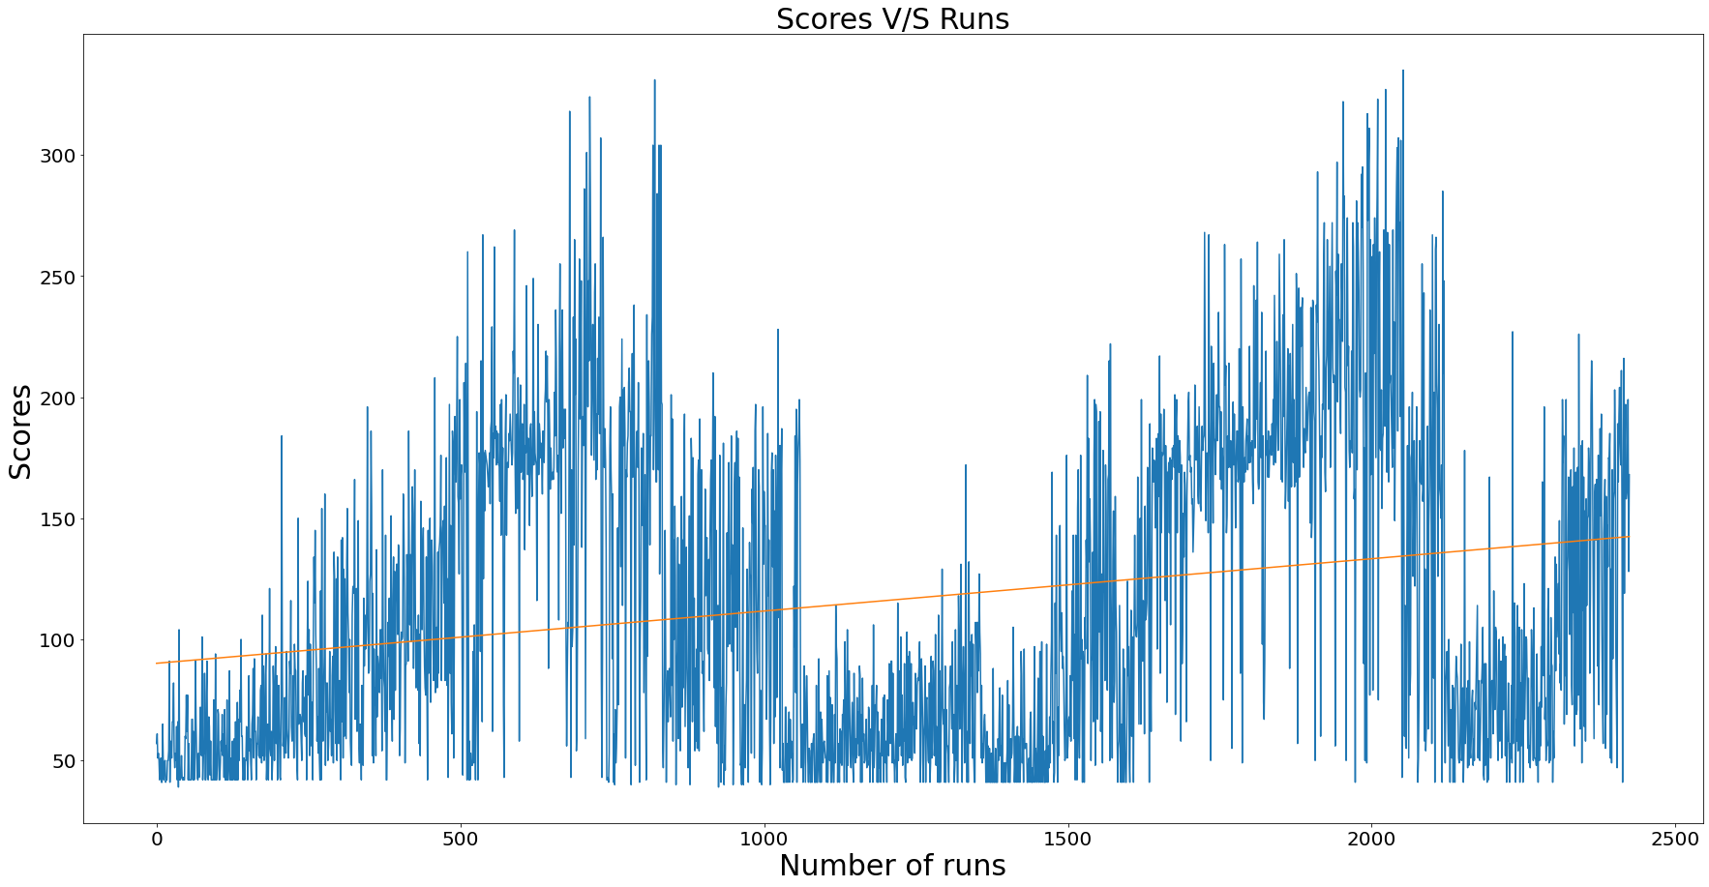
3rd Parameter (Learning Rate - 0.3)

Slide 50
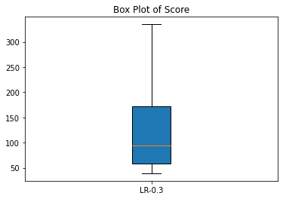
Five-number summary
First_quartile: 58.0
Max: 335
Median: 95.0
Min: 39
Third_quartile: 172.0

Slide 51
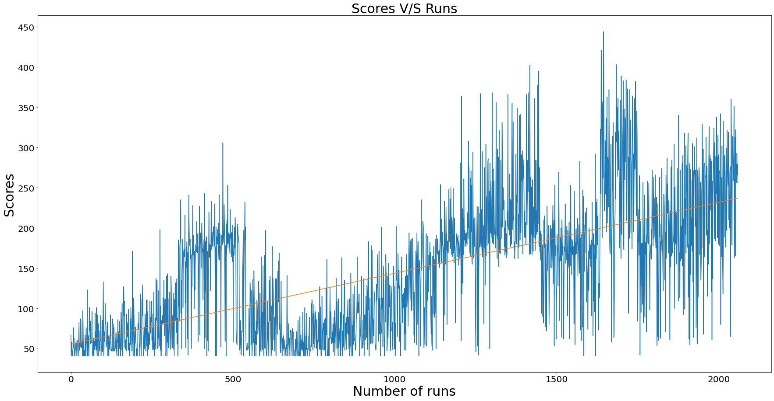
4th Parameter (Learning Rate - 0.4)

Slide 52
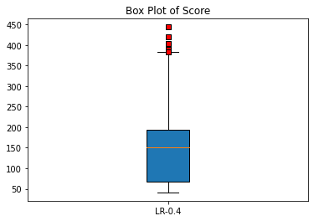
Five-number summary
First_quartile: 68.0
Max: 444
Median: 150.0
Min: 41
Third_quartile: 194.0

Slide 53
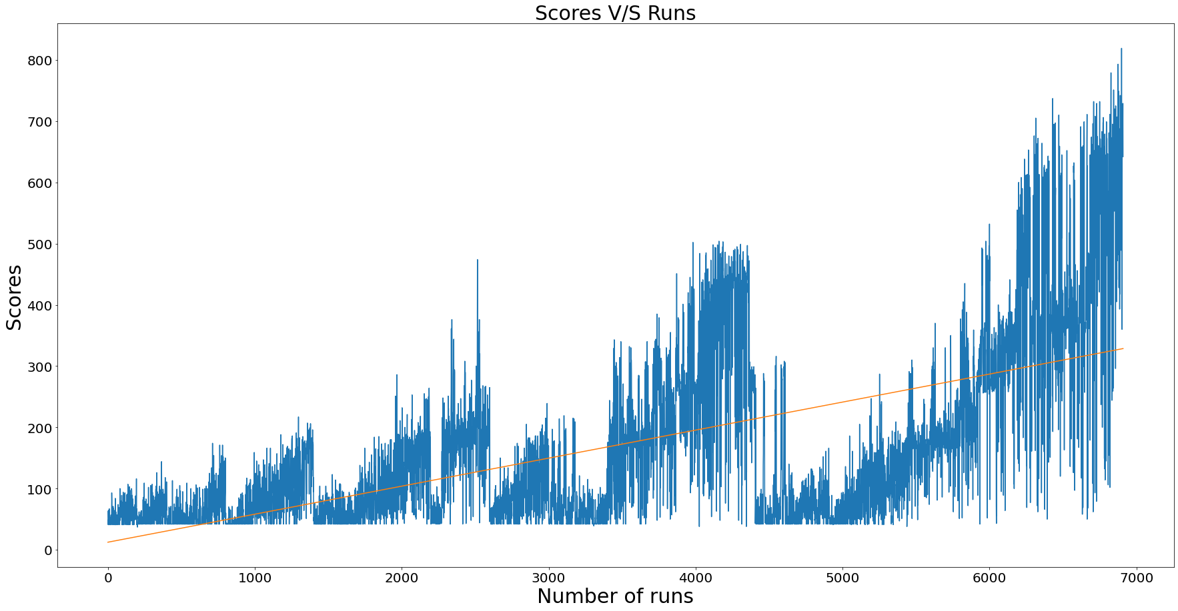
5th Parameter (Learning Rate - 0.5)

Slide 54
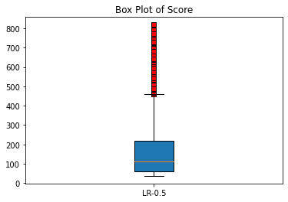
Five-number summary
First_quartile: 59.0
Max: 819
Median: 113.0
Min: 37
Third_quartile: 219.0

Slide 55
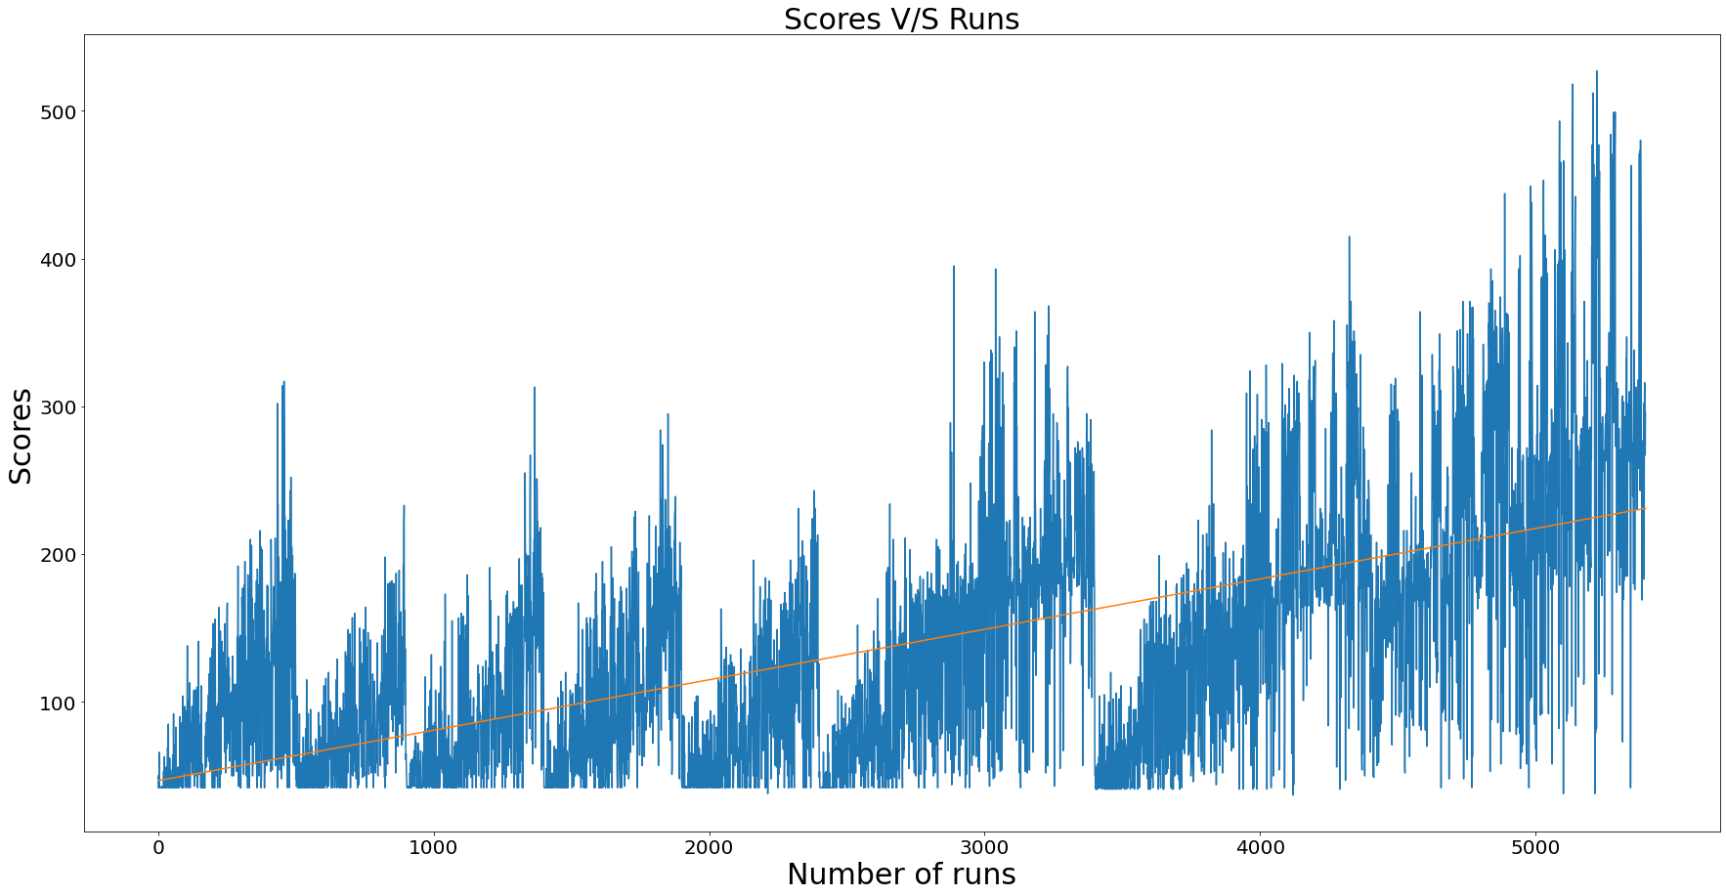
6th Parameter (Learning Rate - 0.6)

Slide 56
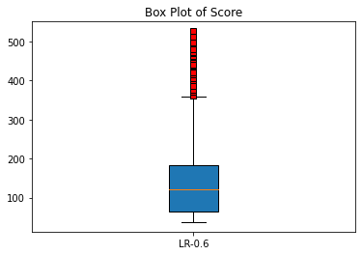
Five-number summary
First_quartile: 65.0
Max: 527
Median: 121.0
Min: 37
Third_quartile: 183.0

Slide 57
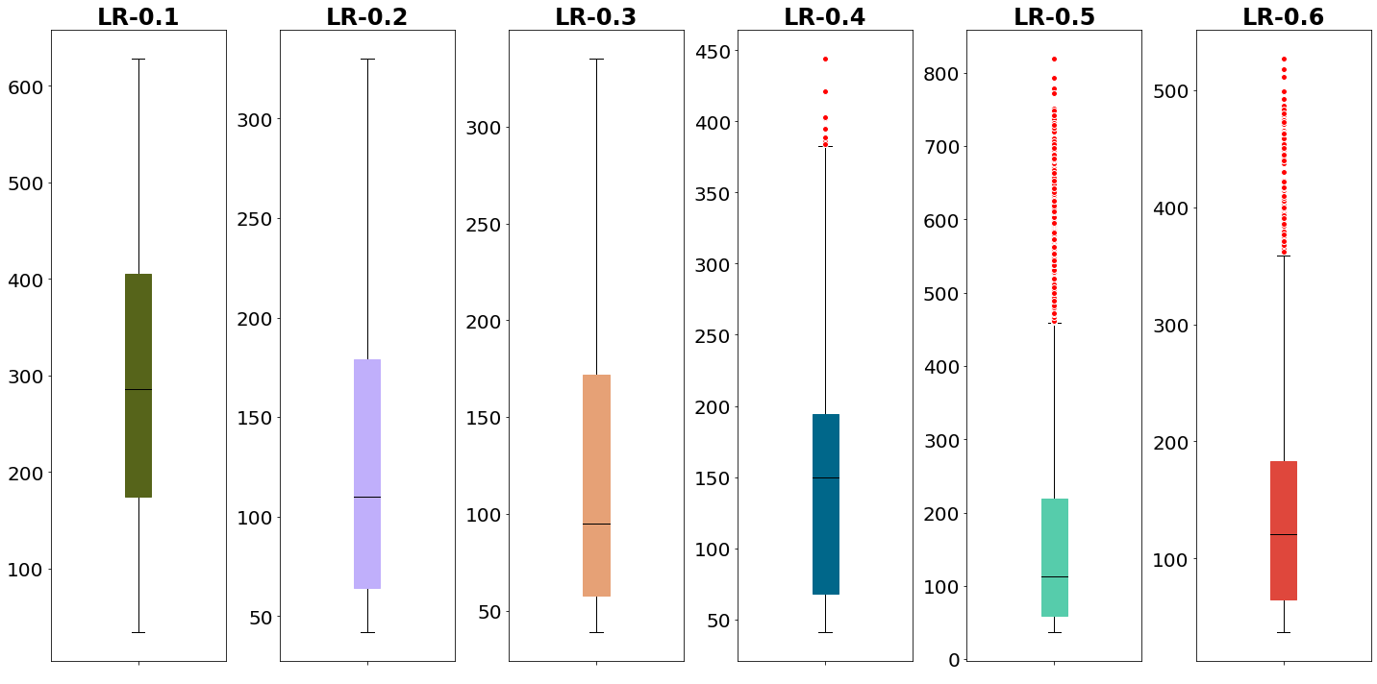
Combined Box Plot

Slide 58
Summarization
Learning Rate | 0.1 | 0.2 | 0.3 | 0.4 | 0.5 | 0.6
No. of runs | 4090 | 2621 | 2425 | 2060 | 6910 | 5400
Max Score of all runs | 628 | 330 | 335 | 444 | 819 | 527
Min Score of all runs | 34 | 42 | 39 | 41 | 37 | 37
Mean | 295.46 | 127.83 | 116.27 | 146.4 | 170.48 | 138.89
Median | 286.0 | 110.0 | 95.0 | 150.0 | 113.0 | 121.0
Standard Deviation | 155.29 | 70.26 | 64.91 | 81.97 | 149.87 | 87.01

Slide 59
Interpretation
0.1 came out to be the best learning rate which was kind of expected, as learning rate 0.1 means that we are giving higher weightage to the current state rather than the future states.
The problem of not getting all the states in one single run is visible through graphs, as there is a sharp decrease in the score in the subsequent runs.
Learning for the higher number of runs results in better scores.
Even though the highest score of learning rate 0.5 is more than that of learning rate 0.1, and that of 0.6 is comparable to that of learning rate 0.1 but that does not mean 0.5 & 0.6 learning rates are better:
They are executed for more number of runs.
Mean and Median of scores of 0.5 and 0.6 learning rate are much lower than that of 0.1, which means 0.5 and 0.6 are performing good only for a few number of runs, whereas 0.1 is performing good for most number of runs.

Slide 60
Challenges faced during the training phase?
Huge amount of states and the combinations of states present.
Required a lot of time to initialize Q-Table with the new states.
It took around 14 hours to run over 1000 episodes in one go and get most of the states for one particular parameter.
We still cannot be sure that we have seen all the states and stored it in the Q-Table.

Slide 61
References
https://medium.com/acing-ai/how-i-build-an-ai-to-play-dino-run-e37f37bdf153
https://youtu.be/LzaWrmKL1Z4
https://youtu.be/DhdUlDIAG7Y
https://towardsdatascience.com/simple-reinforcement-learning-q-learning-fcddc4b6fe56
https://towardsdatascience.com/a-beginners-guide-to-q-learning-c3e2a30a653c
https://towardsdatascience.com/math-behind-reinforcement-learning-the-easy-way-1b7ed0c030f4
https://towardsdatascience.com/math-of-q-learning-python-code-5dcbdc49b6f6

Slide 62
Thank you

